Slide 1
Cycloid Reducer
周奕彬

Slide 2
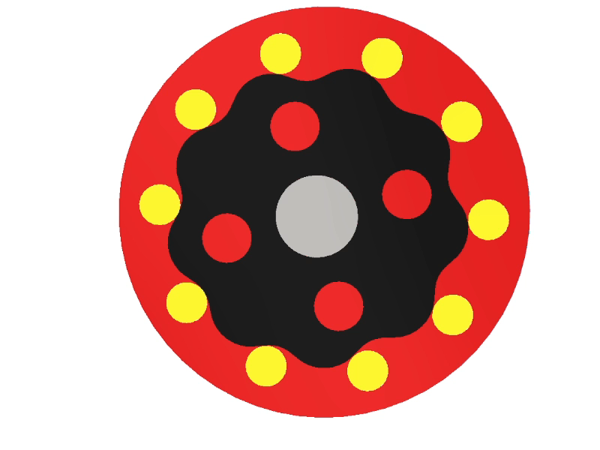
研究目標
擺線減速機誤差分析
求等校連桿簡化分析

Slide 3
大綱
新擺線輪輪廓解析式
等效連桿&曲率半徑
位移方程式
未來目標

Slide 4
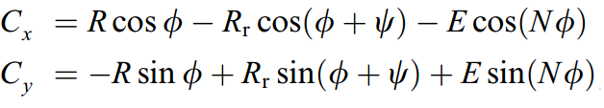
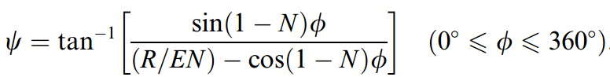
新輪廓解析式
原外擺線解析式

Slide 5
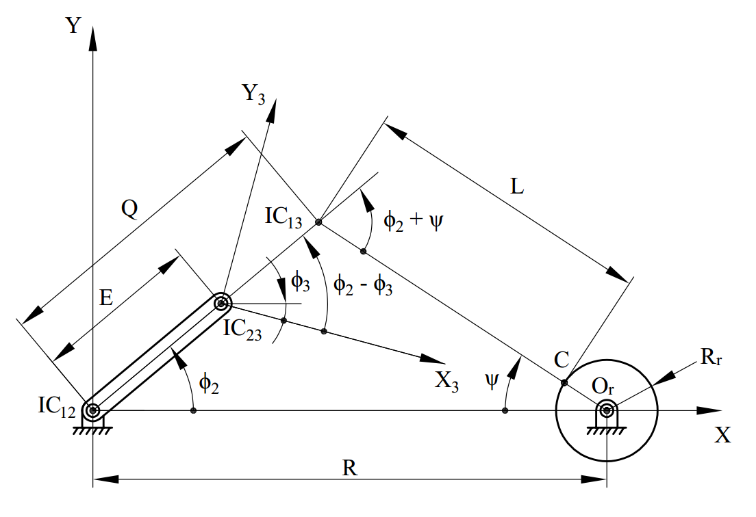
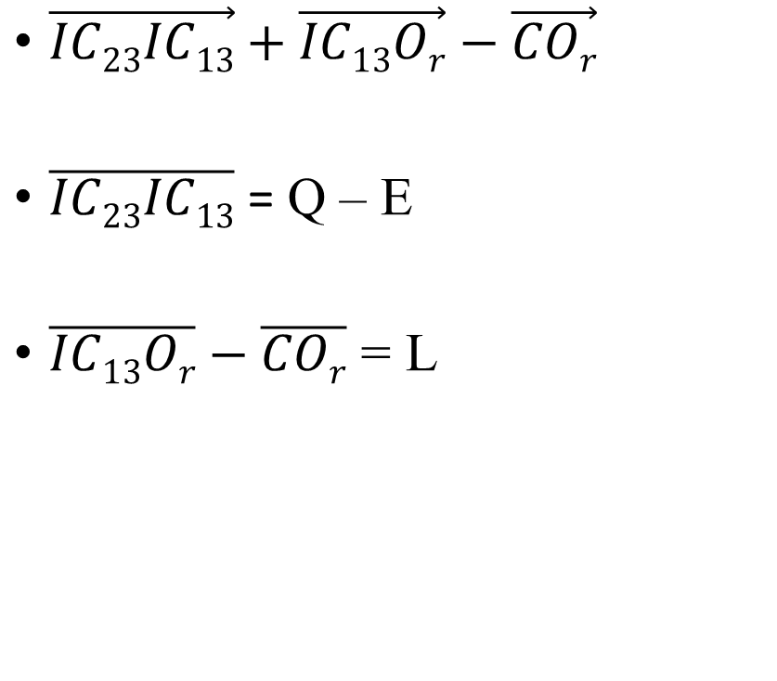
外擺線解析式
$\vec{IC23IC13}+\vec{IC13Or}−\vec{COr}$
$\overline{IC23IC13}$ = Q – E
$\overline{IC13Or}−\overline{COr}$ = L

Slide 6
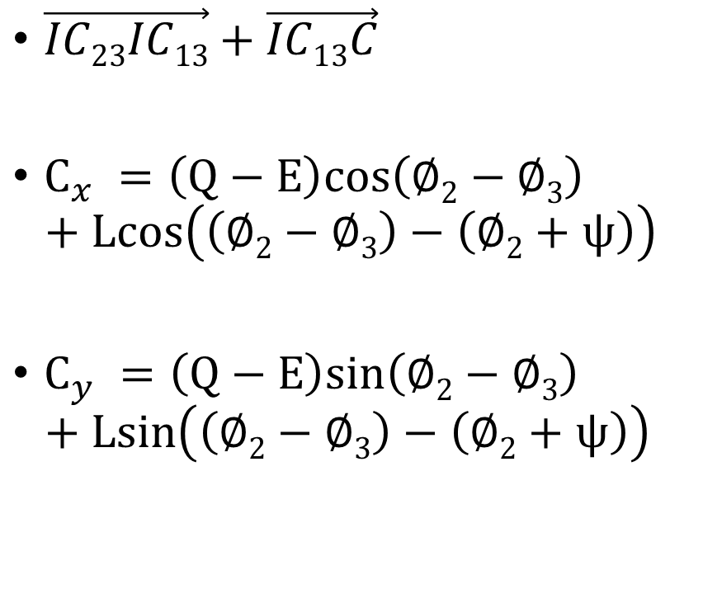
外擺線解析式
$\vec{IC23IC13}+\vec{IC13C}$
$C_{x} =\left(Q−E\right)cos\left(∅2−∅3\right)$
$$+ Lcos\left(\left(∅2−∅3\right)−\left(∅2+ψ\right)\right)$$
$C_{y} =\left(Q−E\right)sin\left(∅2−∅3\right)$
$$+ Lsin\left(\left(∅2−∅3\right)−\left(∅2+ψ\right)\right)$$

Slide 7
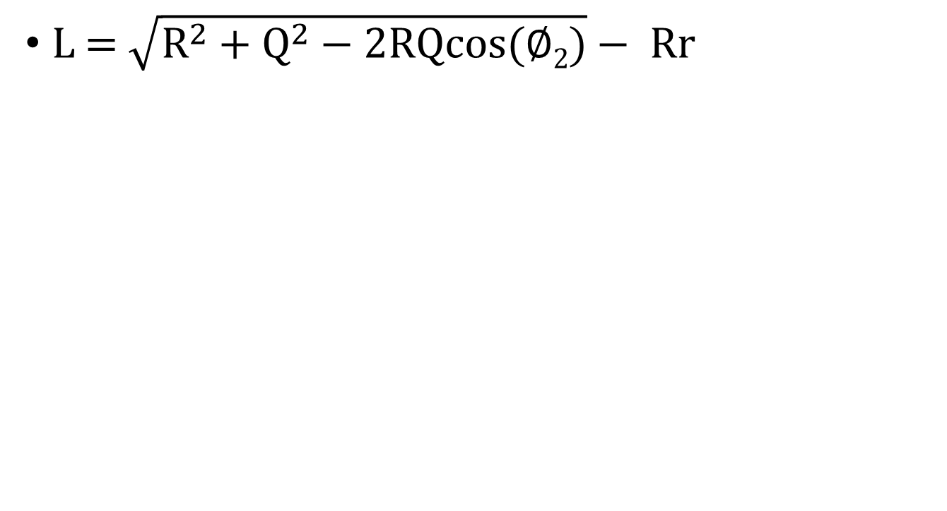
外擺線解析式
L = $\sqrt{R^{2}+Q^{2}−2RQcos(∅2)}− Rr$

Slide 8
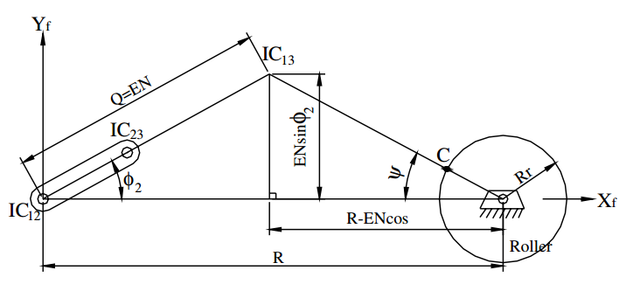
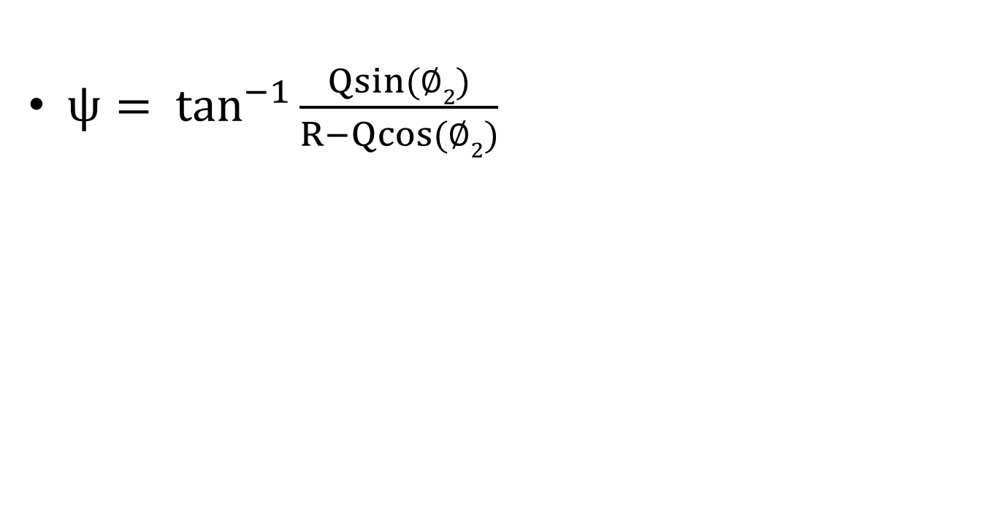
外擺線解析式
$ψ= \tan^{−1}{\frac{Qsin(∅2)}{R−Qcos(∅2)}}$

Slide 9
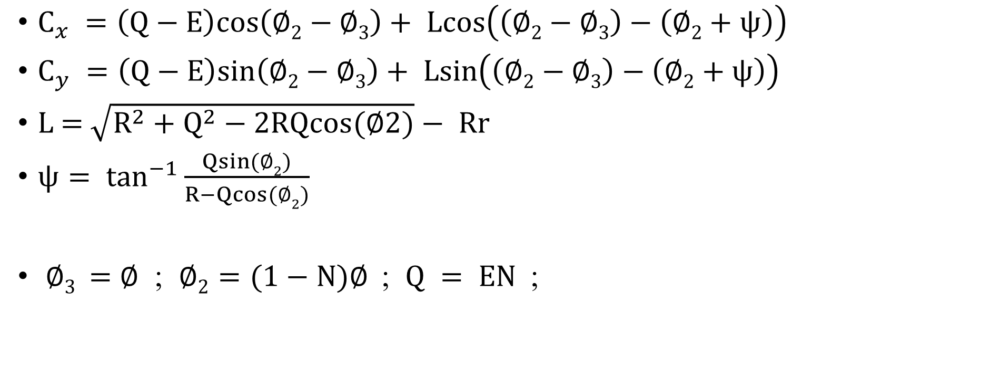
外擺線解析式
$C_{x} =\left(Q−E\right)cos\left(∅2−∅3\right)+ Lcos\left(\left(∅2−∅3\right)−\left(∅2+ψ\right)\right)$
$C_{y} =\left(Q−E\right)sin\left(∅2−∅3\right)+ Lsin\left(\left(∅2−∅3\right)−\left(∅2+ψ\right)\right)$
L = $\sqrt{R^{2}+Q^{2}−2RQcos(∅2)}− Rr$
$ψ= \tan^{−1}{\frac{Qsin(∅2)}{R−Qcos(∅2)}}$
$∅3 =$ $∅$ ; $∅2=(1−N)∅$ ; $Q = EN$;

Slide 10
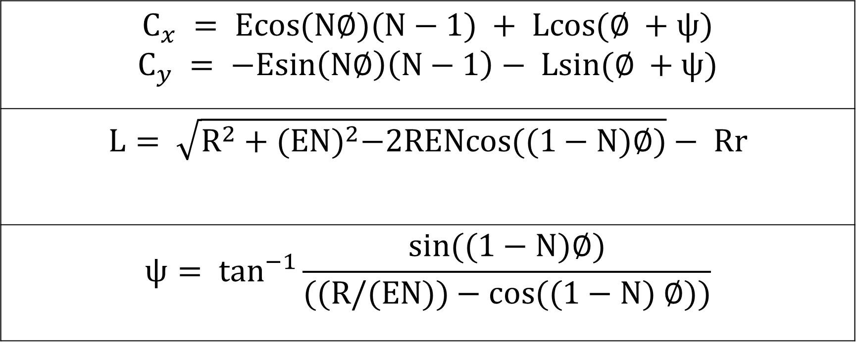
外擺線解析式
$$C_{x} = Ecos(N∅)(N−1) + Lcos(∅ +ψ)$$ $$C_{y} = −Esin\left(N∅\right)\left(N−1\right)− Lsin(∅ +ψ)$$
$$L= \sqrt{R^{2}+{(EN)}^{2}−2RENcos((1−N)∅)}− Rr$$
$$ψ= \tan^{−1}{\frac{sin((1−N)∅)}{((R/(EN))−cos((1−N) ∅))}}$$

Slide 11
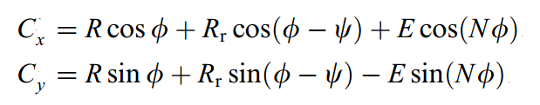
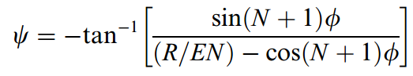
新輪廓解析式
原內擺線解析式

Slide 12
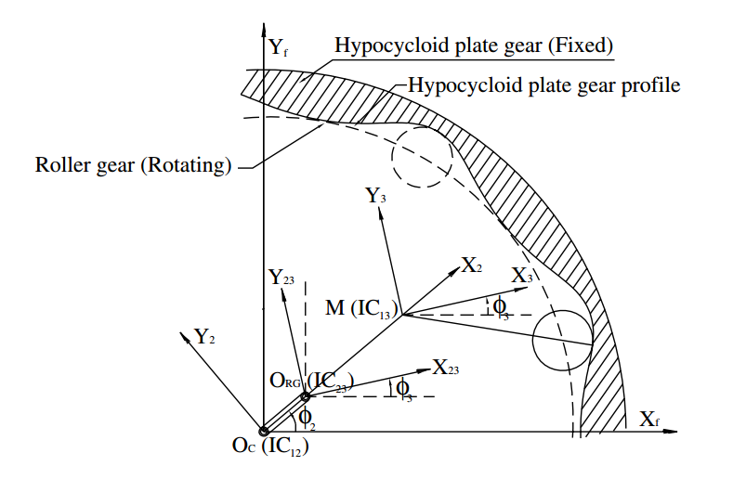
內擺線解析式

Slide 13
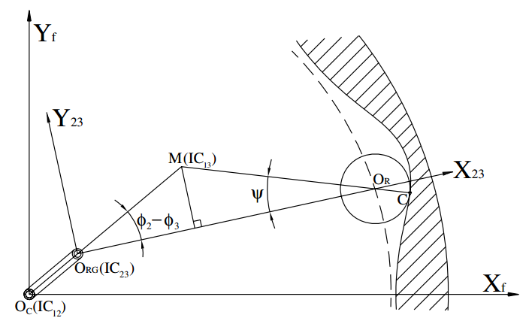
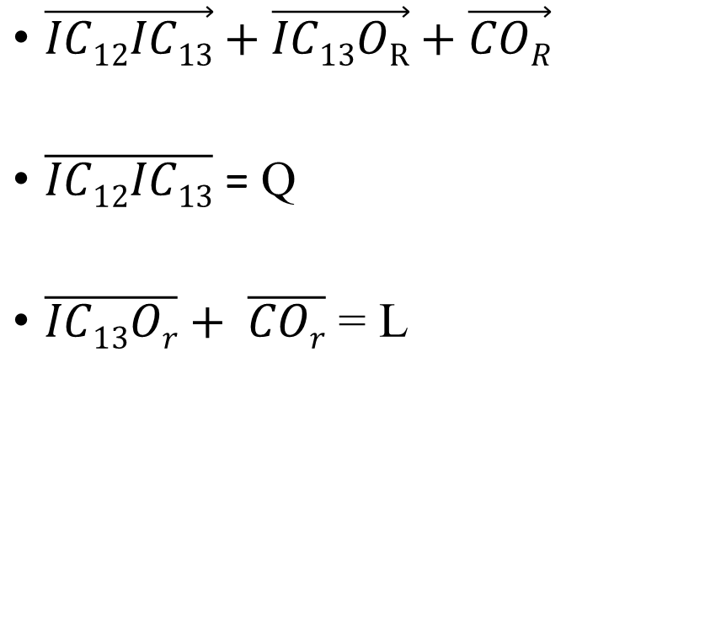
外擺線解析式
$\vec{IC12IC13}+\vec{IC13OR}+\vec{COR}$
$\overline{IC12IC13}$ = Q
$\overline{IC13Or}+ \overline{COr}$ = L

Slide 14
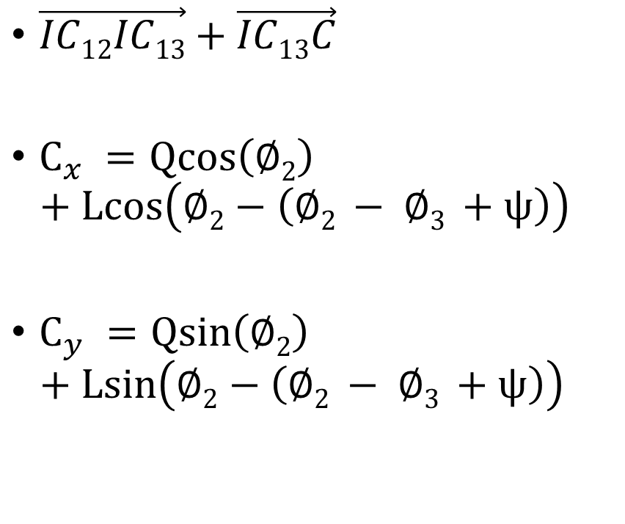
外擺線解析式
$\vec{IC12IC13}+\vec{IC13C}$
$C_{x} =Qcos\left(∅2\right)$
$$+ Lcos\left(∅2−\left(∅2 − ∅3 +ψ\right)\right)$$
$C_{y} =Qsin\left(∅2\right)$
$$+ Lsin\left(∅2−\left(∅2 − ∅3 +ψ\right)\right)$$

Slide 15
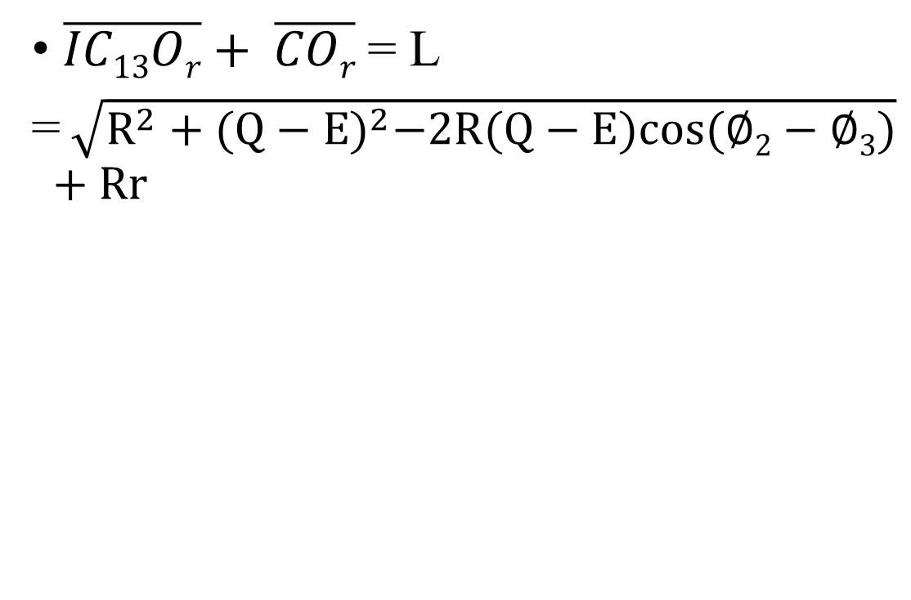
外擺線解析式
$\overline{IC13Or}+ \overline{COr}$ = L
= $\sqrt{R^{2}+{(Q−E)}^{2}−2R(Q−E)cos(∅2−∅3)}$
$$+ Rr$$

Slide 16
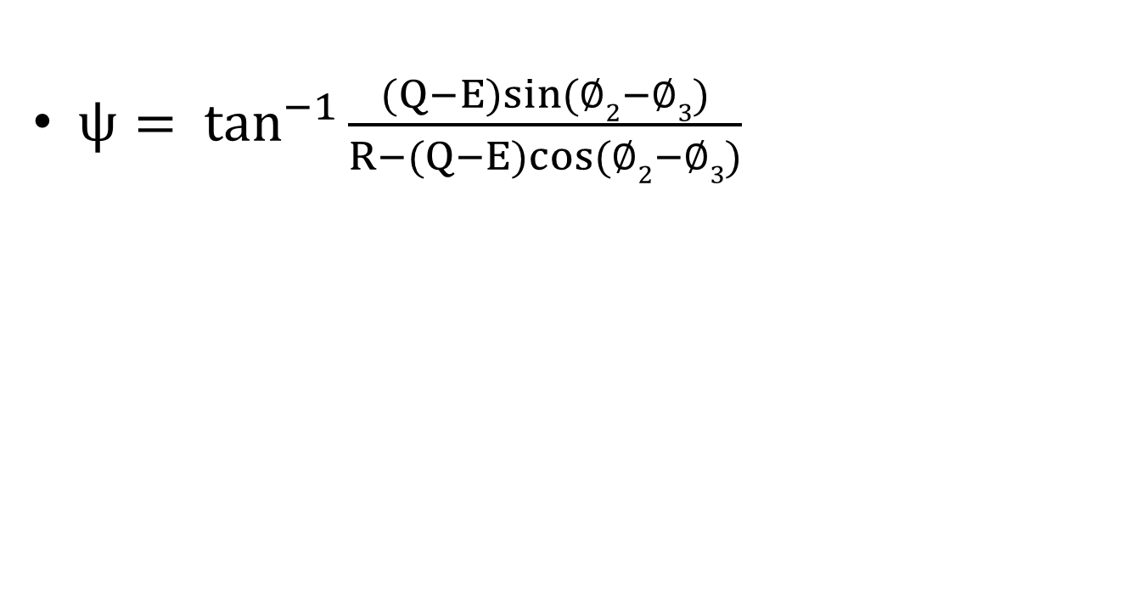
外擺線解析式
$ψ= \tan^{−1}{\frac{(Q−E)sin(∅2−∅3)}{R−(Q−E)cos(∅2−∅3)}}$

Slide 17
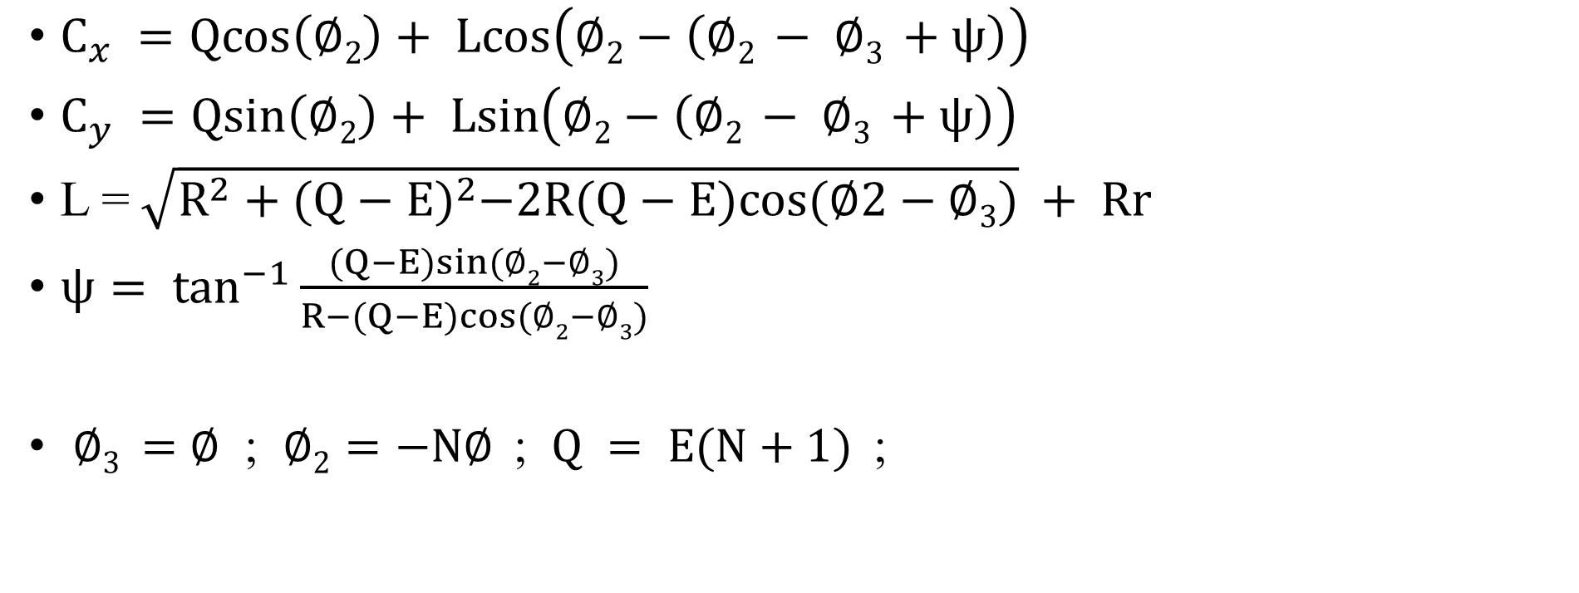
外擺線解析式
$C_{x} =Qcos\left(∅2\right)+ Lcos\left(∅2−\left(∅2 − ∅3 +ψ\right)\right)$
$C_{y} =Qsin\left(∅2\right)+ Lsin\left(∅2−\left(∅2 − ∅3 +ψ\right)\right)$
L = $\sqrt{R^{2}+{(Q−E)}^{2}−2R(Q−E)cos(∅2−∅3)} + Rr$
$ψ= \tan^{−1}{\frac{(Q−E)sin(∅2−∅3)}{R−(Q−E)cos(∅2−∅3)}}$
$∅3 =$ $∅$ ; $∅2=−N∅$ ; $Q = E(N+1)$;

Slide 18
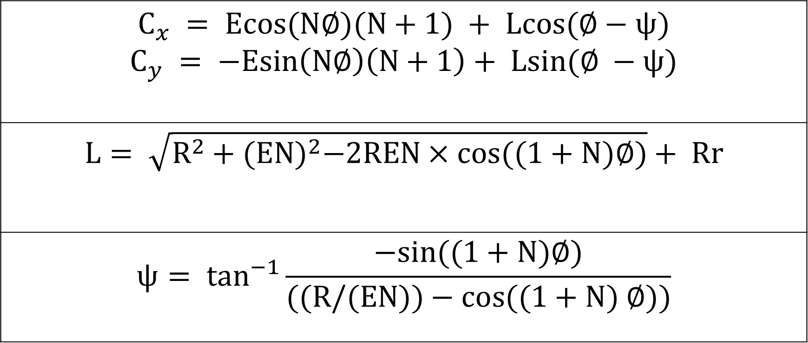
外擺線解析式
$$C_{x} = Ecos(N∅)(N+1) + Lcos(∅−ψ)$$ $$C_{y} = −Esin\left(N∅\right)\left(N+1\right)+ Lsin(∅ −ψ)$$
$$L= \sqrt{R^{2}+{(EN)}^{2}−2REN×cos((1+N)∅)}+ Rr$$
$$ψ= \tan^{−1}{\frac{−sin((1+N)∅)}{((R/(EN))−cos((1+N) ∅))}}$$

Slide 19
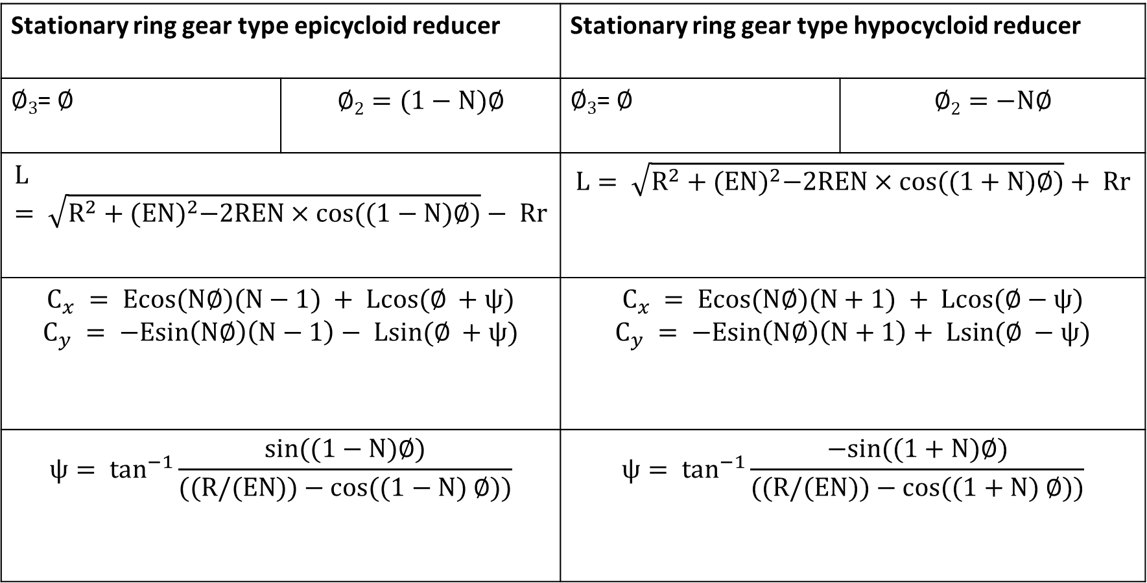
Stationary ring gear type epicycloid reducer |  | Stationary ring gear type hypocycloid reducer
$∅3$= $∅$ | $$∅2=(1−N)∅$$ | $∅3$= $∅$ | $$∅2=−N∅$$
$$L= \sqrt{R^{2}+{(EN)}^{2}−2REN×cos((1−N)∅)}− Rr$$ |  | $$L= \sqrt{R^{2}+{(EN)}^{2}−2REN×cos((1+N)∅)}+ Rr$$
$$C_{x} = Ecos(N∅)(N−1) + Lcos(∅ +ψ)$$ $$C_{y} = −Esin\left(N∅\right)\left(N−1\right)− Lsin(∅ +ψ)$$ |  | $$C_{x} = Ecos(N∅)(N+1) + Lcos(∅−ψ)$$ $$C_{y} = −Esin\left(N∅\right)\left(N+1\right)+ Lsin(∅ −ψ)$$
$$ψ= \tan^{−1}{\frac{sin((1−N)∅)}{((R/(EN))−cos((1−N) ∅))}}$$ |  | $$ψ= \tan^{−1}{\frac{−sin((1+N)∅)}{((R/(EN))−cos((1+N) ∅))}}$$

Slide 20
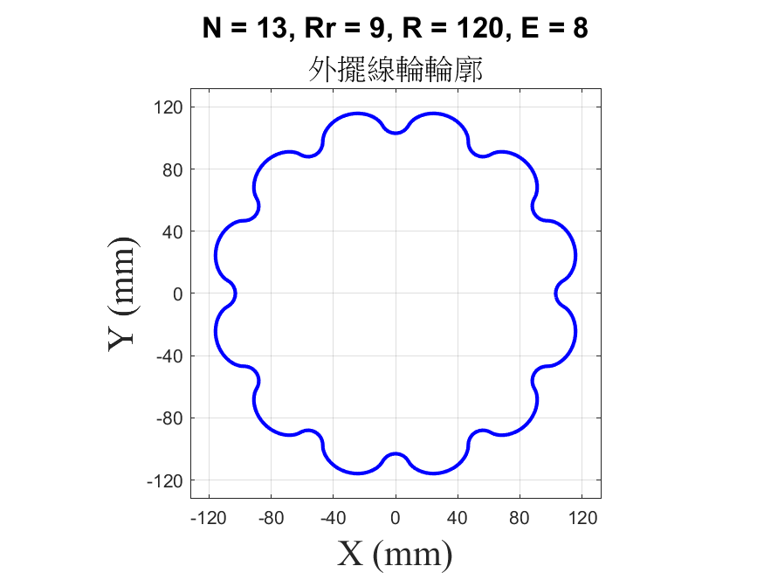
曲率半徑
N = 13
Rr = 9 mm
R = 120 mm
E =8 mm

Slide 21
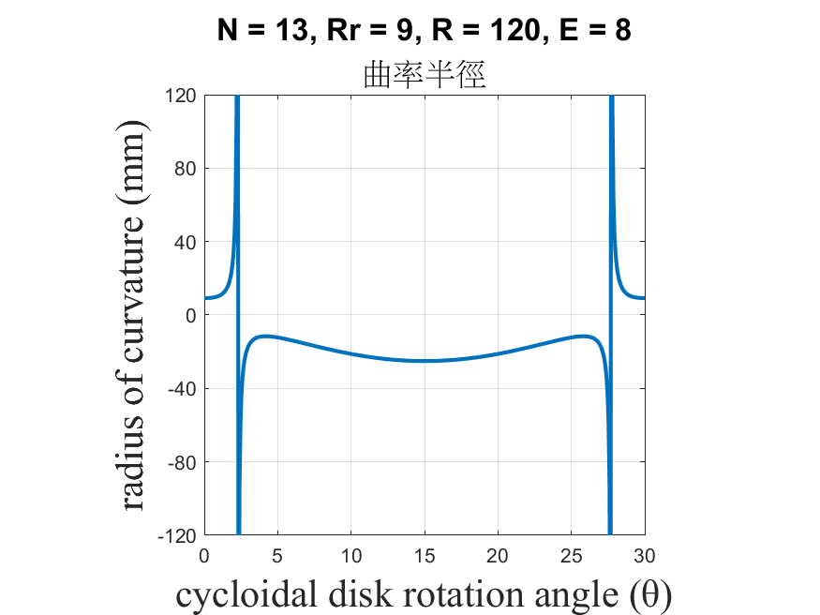
曲率半徑

Slide 22
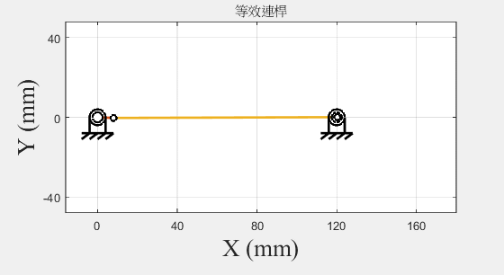
等效連桿

Slide 23
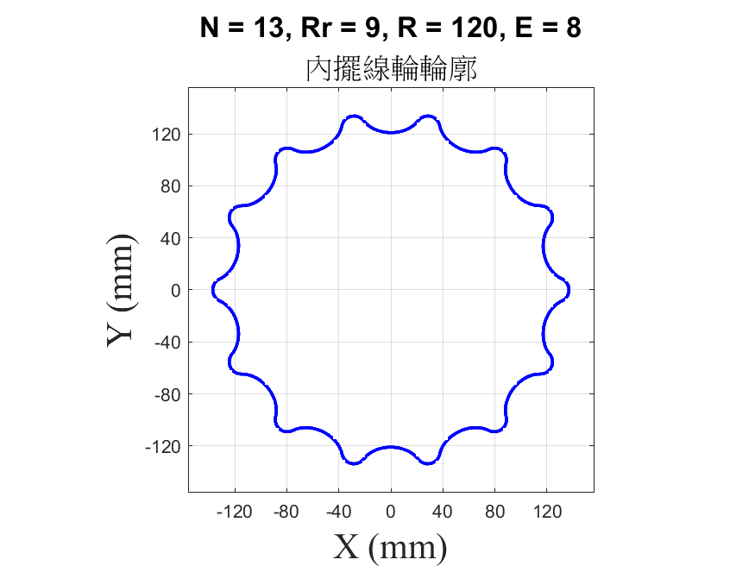
曲率半徑
N = 13
Rr = 9 mm
R = 120 mm
E =8 mm

Slide 24
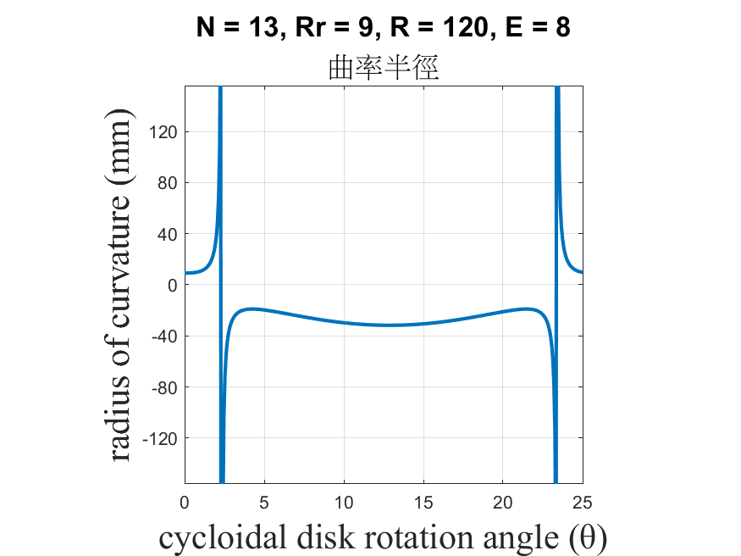
曲率半徑

Slide 25
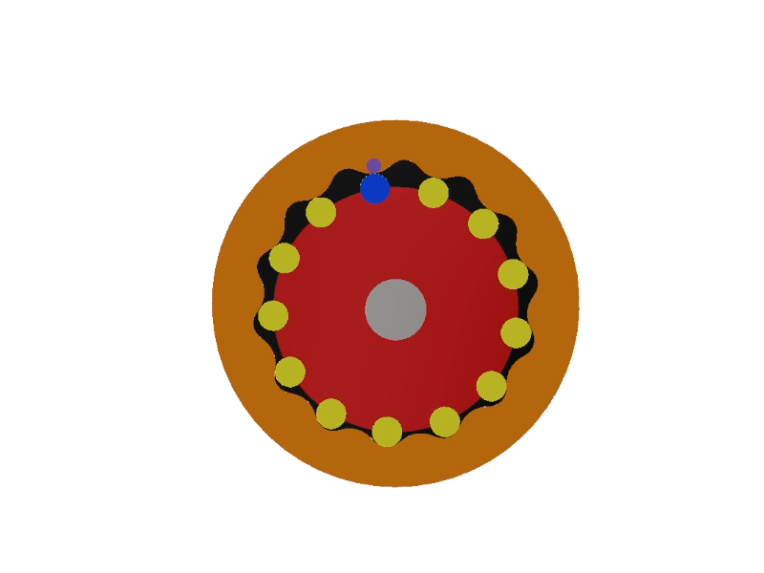
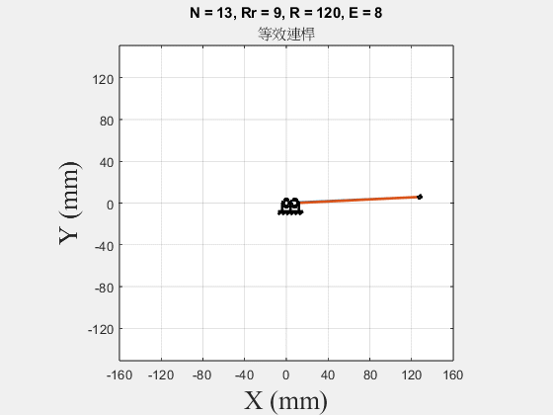
等效連桿

Slide 26
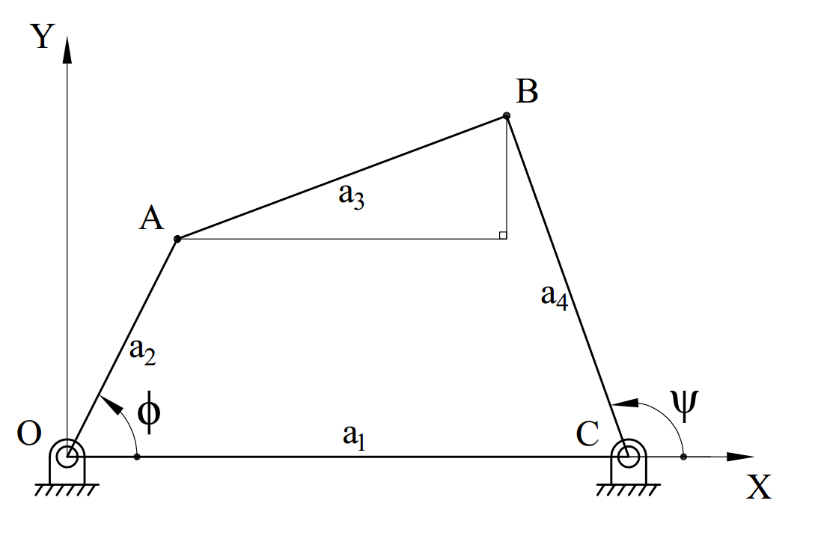
位移方程式

Slide 27
位移方程式
A(a₂cosϕ, a₂sinϕ)
B(a­₁ + a₄cosψ, a₄sinψ)
(a₁ + a₄cosψ − a₂cosϕ)² + (a₄sinψ − a₂sinϕ)² = a₃²

Slide 28
未來目標
轉換角
將等效連桿參數代入位移方程式
做各接觸點誤差分析

